Slide 1
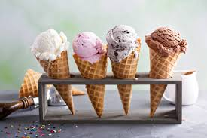
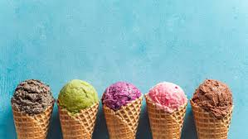
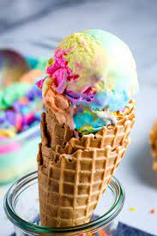
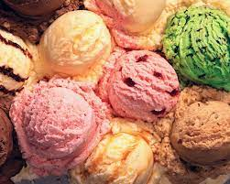
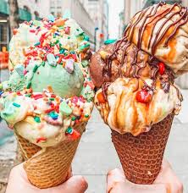

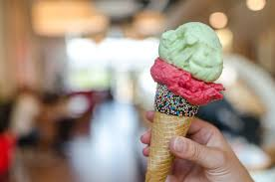
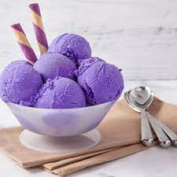
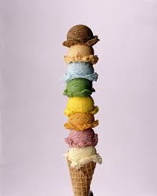

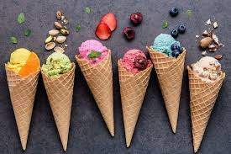
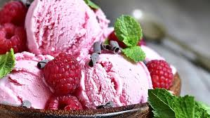
What do you think todays assembly Is about??

Slide 2
Miss Ilic’s 3 most favourite ice creams
Black Cherry
Coconut
Banana

Slide 3

Attendance
Where Every Day counts

Slide 4
What does attendance mean?
Attendance is the word used to describe how many days you’ve attended school each year.
Every day you come to school, you gain two more attendance marks.
You can gain a total of 380 attendance marks every school year.

Slide 5
What does good attendance mean for me?
Better life chances
Better opportunities
The finishing touch on your CV
Evidence of commitment
Understanding of routines and expectations

Slide 6
So what?
What is the impact if I am absent from school?

Slide 7
What is the impact if I am absent from school
You will miss out on vital learning, rewards, being chosen for a leadership role, seeing your friends & having fun
We will need to provide a reference for you for your Secondary school

Slide 8
What good attendance looks like
100% attendance – the very best chance of success
96%+ attendance – your attendance is good; keep it up!
93%+ attendance – try to come to school every day for the rest of this year
Less than 93% - you should work hard to immediately improve your attendance

Slide 9
How can I improve my attendance?
Come
Come to school every day, even if you don’t always feel up to it – your exams are your future
Make
Make sure you’re at school on time, ready for your first lesson – and make every lesson count!
Spread
Spread the word: encourage your friends too!

Slide 10
Targets
Be the class in your KS to win the attendance trophy the most times throughout the term.
Each class to achieve 96%+ every week.
Win the attendance challenge to be in with the chance of winning a end of term treat!!

