Slide 1





Slide 2
What does SATs Stand For?
Statutory Assessment Tests
Taken at the end of Key Stage 1 (Y2) and at the end of Key Stage 2 (Y6).
The purpose of the SATS is to assess the children’s understanding of all taught knowledge from that Key Stage.

Slide 3
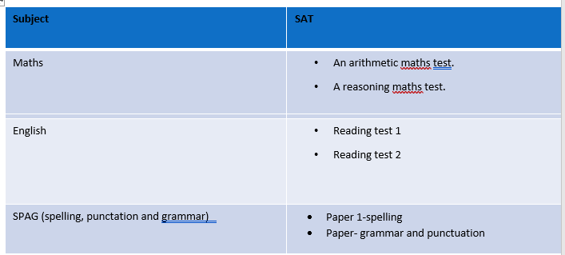
What are the children tested in?
Maths and English.
There is no writing paper. Children are assessed throughout the year in their writing lessons.
We have the month of May to administer the tests.

Slide 4

How are SATs organised?
First of all, do not panic. The testing is organized in a way that will feel as informal as possible for the children.
To them, it will feel like a regular Maths or English lesson and just like one of the many other assessments we do throughout the year. We also never refer to them as ‘SATs’ to the children.
Tests are completed in classrooms, with all displays and resources covered up.

Slide 5
Mathematics
Children will sit two tests: Paper 1 and Paper 2:
Paper 1 is for arithmetic, lasting approximately 25 minutes and worth 25 marks. It covers calculation methods for all operations.
Paper 2 covers problem solving, reasoning and mathematical fluency, lasts for approximately 35 minutes and is worth 35 marks. This paper includes some (5) mental maths questions.

Slide 6
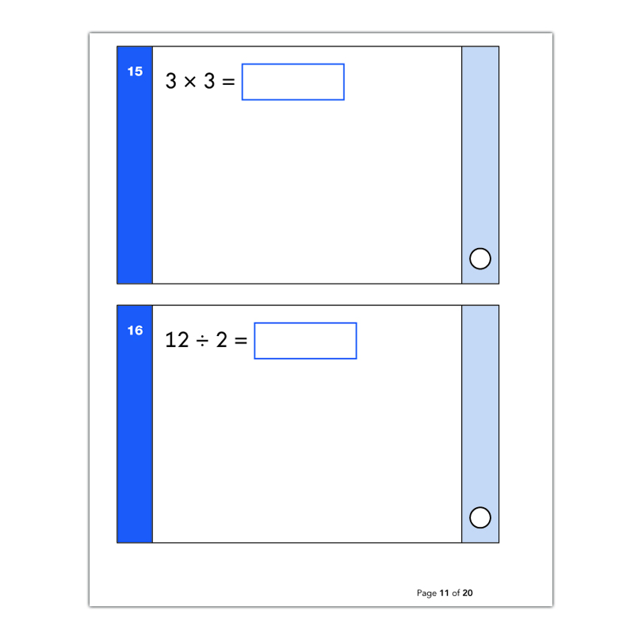
Maths Paper 1-Arithmetic

Slide 7
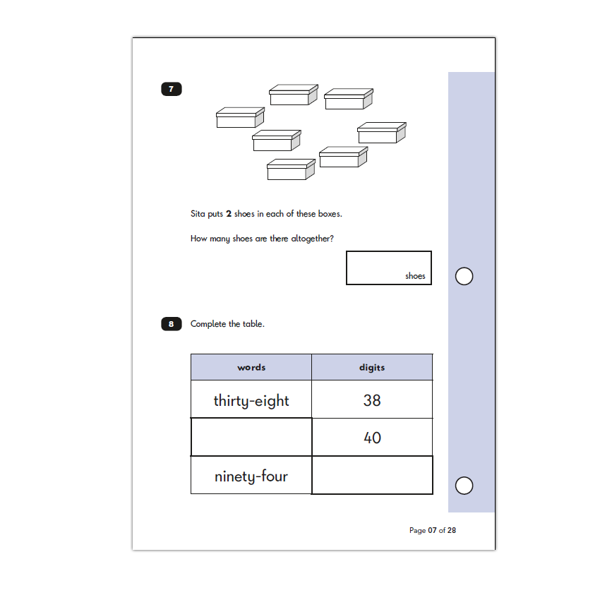
Maths Paper 2-Reasoning

Slide 8
Reading
The Reading Test consists of two separate papers:
Paper 1 – Contains a selection of texts totalling between 400 and 700 words with questions about the text.
Paper 2 – Contains a reading booklet of a selection of passages totalling 800 to 1100 words. Children will write their answers to questions about the passage in a separate booklet.
Each paper is worth 50% of the marks and should take approximately 30 minutes to complete, although the children are not being assessed at working at speed so will not be strictly timed.
The texts will cover a range of poetry, fiction and non-fiction.
Questions are designed to assess the comprehension and understanding of a child’s reading.
Some questions are multiple choice or selected response, others require
short answers and some require an extended response or explanation.

Slide 9
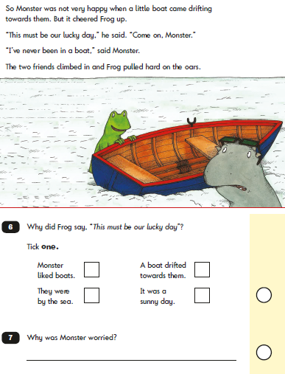

Slide 10
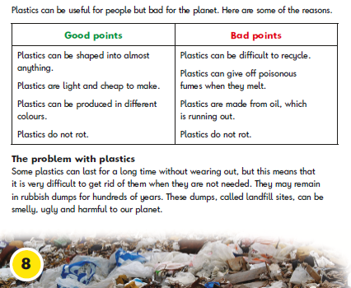

Slide 11
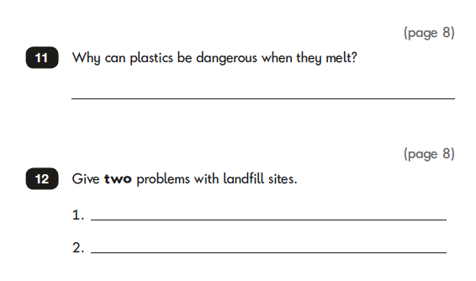

Slide 12
SPAG
Paper 1-spelling
Children will be asked to spell 20 different words using the spelling rules they have been taught in Key Stage 1. It is worth 20 marks and last approximately 15 minutes.

Slide 13
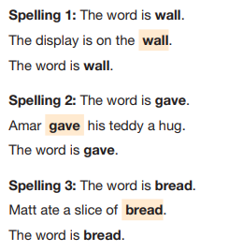
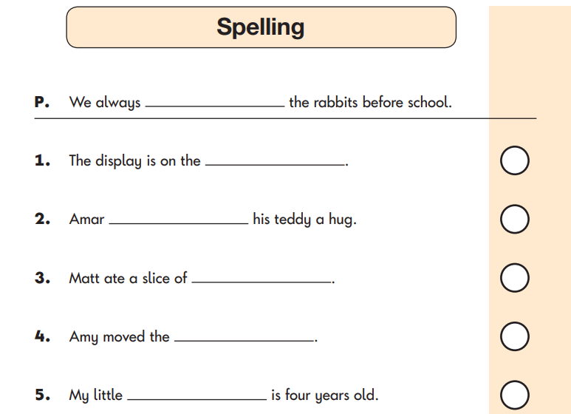

Slide 14
Paper 2 –grammar and punctuation
Children will be asked a variety of questions to assess their understanding of grammar, punctuation and vocabulary. It is worth 20 marks and will last approximately 20 minutes.

Slide 15
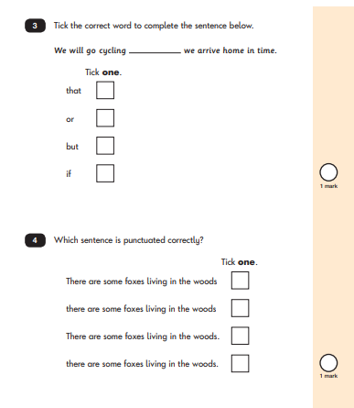

Slide 16
Does the SATs score determine what ‘judgement’ my child has at the end of Y2?
Yes and no. In Y2, judgements are ‘teacher assessed’.
Unlike Y6 (where the SATs score is absolute), the Y2 teachers assess what ‘judgement’ your child has achieved – working below, working towards, working at the expected standard for Y2, or greater depth.

Slide 17
What does teacher assessment involve and is it different from testing?
Teacher assessment draws together everything the teacher knows about a child, including observations, marked work and school assessments.
Teacher assessment is not a ‘snapshot’ like tests and is therefore more reliable.
We use a collection of material to form our judgement: book-band, words per minute, exercise books from across the curriculum, test scores from across the year, and of course, SATs.

Slide 18

How can parents help?
First and foremost, support and reassure your child that there is nothing to worry about and that they should always just try their best. Praise and encourage!
Ensure your child has the best possible attendance at school.
Support your child with any homework tasks.
Reading, spelling and arithmetic (e.g. times tables) are always good to practise.
Talk to your child about what they have learnt at school and what book(s) they are reading (the character, the plot, their opinion).
Make sure your child has a good sleep and healthy breakfast every morning!

